Slide 1
Proposal to the ACM Publications Board to Mandate Collection of ORCIDs
Scott Delman and Ashley Petrylak
Edited by Jonathan Aldrich for SGB Presentation
October 23, 2020

Slide 2
What is an ORCID?
A persistent digital identifier that you own and control, and that distinguishes you from every other researcher
Can connect with your professional information — affiliations, grants, publications, peer review, etc.
Can be used to share your information with other systems, ensuring you get recognition for your contributions
Has become the global standard identifier for authors
  9,375,000+ ORCIDs registered globally
Simple sign up process at www.orcid.org
  Initial sign up only requires name, email, and selection of visibility level to new items added to your ORCID record (about 30-45 seconds)
  Adding biography page information enhances a user’s record, but is not mandatory (although we will want to convince as many authors as possible to update their biographical information over time)

Slide 3
Why Now?
ACM has collected ORCIDs in various ways for years (optionally) but never reached critical mass. Today, we only have ~3,000 ORCIDs.
Data quality remains one of the major challenges with the DL, and author name disambiguation will help ACM address one aspect of data quality
New ACM Open model depends heavily on accurate author name and affiliation data
Widescale use of ORCID will support various ACM policies, systems, and implementation efforts (i.e. COI systems, eRights system, E+P investigations, ACM Open reporting, various Pubs policies, etc.)
Many of our peers have already taken this step (i.e. IEEE)
We believe mandating ORCID registration for all authors is the only way to achieve widescale use
Proposed phased roll out from Jan 2021 through Dec 2022
  Journals and magazines mandate to start Jan 2021 (completion Dec 2021)
  Proceedings mandate to start end 2021 (completion Dec 2022)

Slide 4
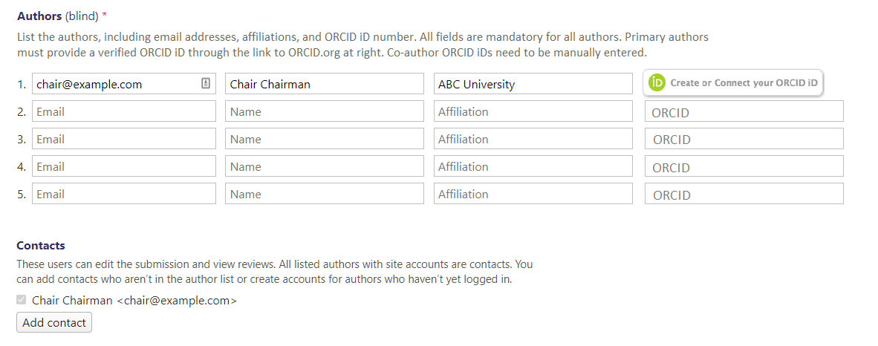
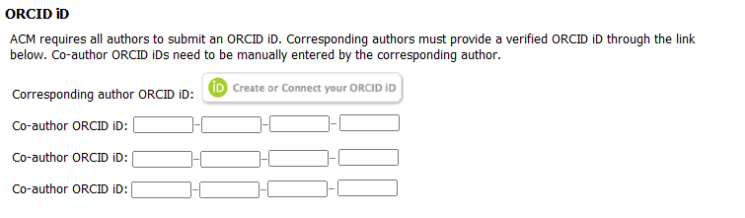
Sign on Process for Authors
We will prioritize having authors enter and authenticate ORCIDs at submission, as this will allow us to capture as many authors as possible For submission systems that are slow to integrate or conferences that do not use systems, ORCIDs will be collected in the eRights form
Submission System Sample
eRights Form Sample

Slide 5
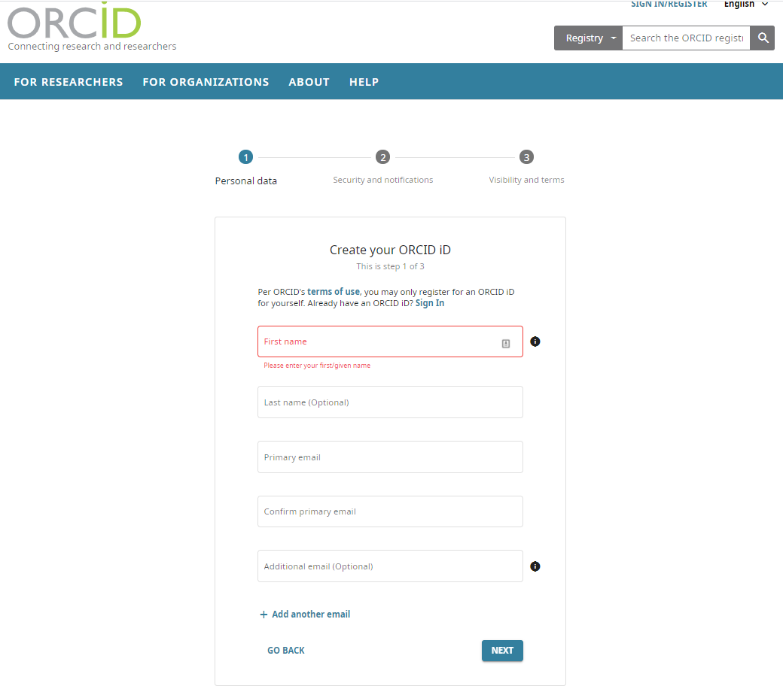
ORCID Registration – Name & Email

Slide 6
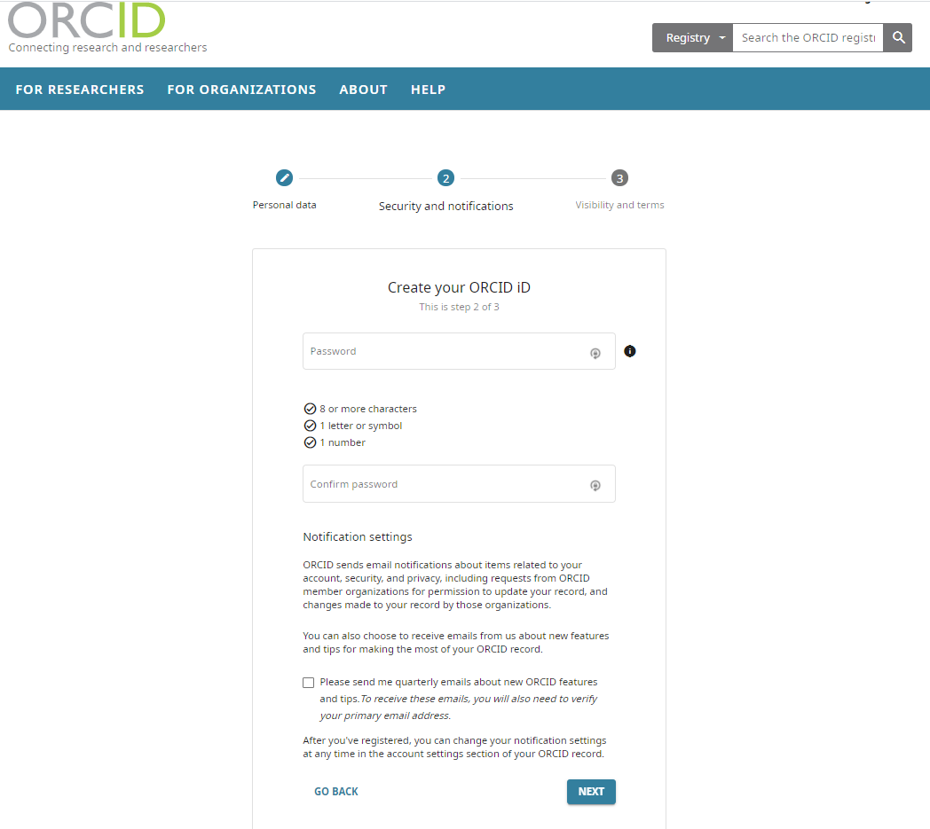
ORCID Registration – Password

Slide 7
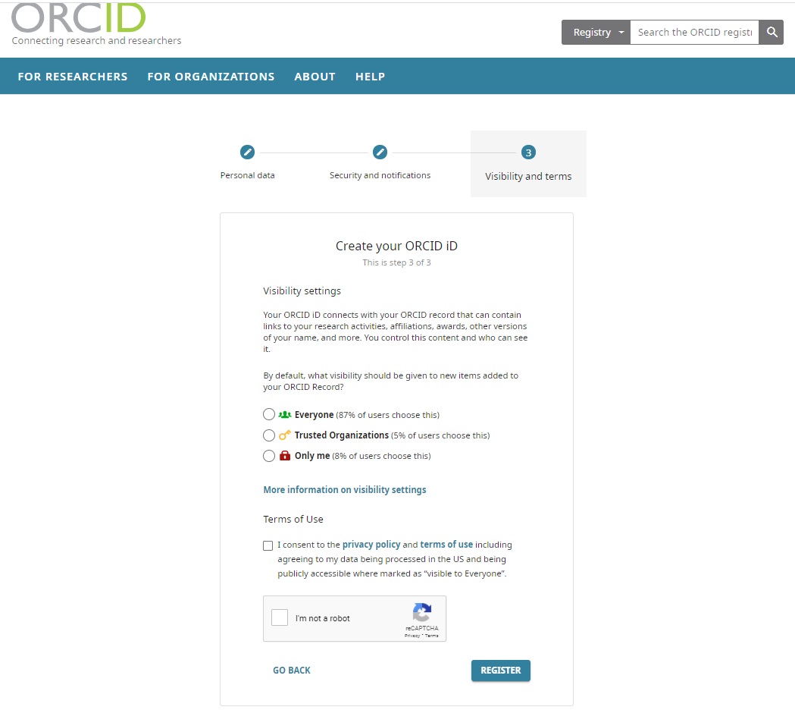
ORCID Registration – Visibility Settings

Slide 8
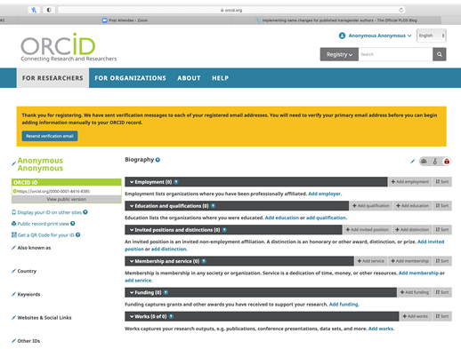
ORCID Registration Process –
Biographical Information

Slide 9
Publications Board Resolutions
Resolution #1
“The ACM Publications Board hereby approves the proposal to require that all ACM authors register and/or provide ACM with their valid ORCID upon submission and/or acceptance of their Work by ACM. Implementation of the mandate for ACM journals and magazines will start on January 1, 2021 with a targeted completion of December 31, 2021.”
Resolution #2
“The Publications Board will recommend implementation of the mandate for ACM conferences will start on January 1, 2022 with a targeted completion of December 31, 2022, assuming the SGB is supportive of the mandate.”

Slide 10
Questions & Discussion

Slide 11
Backup Slides

Slide 12
Keys to a Successful Rollout
Buy-in and support from ACM Leadership (i.e.Pubs Board, SGB, conference leadership, EICs, Editorial Boards, PCs, etc.)
Strong and clear communications to stakeholders in advance of mandate and throughout rollout (SIGs and ACM conferences will be biggest challenge, but also biggest benefit for ACM)
Ensure a simple process for authors
Improved author experience on DL profile pages, increased discoverability, more accurate professional record, etc.
Staff resource to assist authors with ORCID registration, adding ORCID to profile pages, answer general questions, etc.
Visible plan / roadmap to take advantage of the ORCID metadata in the DL
Entire community will need to see the tangible benefits for continued and long-term support of mandate

Slide 13
Key Author Benefits
Improved accuracy of author profile information in the ACM DL
Increased discoverability of an author’s full body of work on their ORCID page
Integration of arXiv activity
ACM can update an author’s ORCID profile (where allowed) by pushing the ACM published work
ACM will include ORCIDs in Crossref deposits which will propagate into many tools and services built on top of that data, which will be used by organizations like CHORUS
Allow for more straightforward maintenance of author pages in key bibliographic database such as DBLP
Identification of authors who are eligible for the ACM Open program
Seamless login for journal authors through ScholarOne and Editorial Manager with autofill options (we plan to work with conference submission systems to do the same over time)

Slide 14
Key ACM Benefits
Improved accuracy and cleanliness of author profile information in the ACM DL
Identification of Conflict of Interest among authors/reviewers
Identification of authors who are eligible for the ACM Open program
More robust data about author behavior and activity, which could also be linked to ACM membership database
Display full publication history on authors’ DL profile pages if authors allow data to flow to ACM from their ORCID page
Enhanced and curated coverage of GUIDE content through indexing of authors’ non-ACM published content

