Slide 1
Accessible Conferences
Shari Trewin, SIGACCESS Chair

Slide 2
SIGACCESS
ACM SIGACCESS supports the international community of researchers and professionals applying computing and information technologies to empower individuals with disabilities and older adults. The SIG also promotes the professional interests of students and computing personnel with disabilities and strives to educate the public to support careers for people with disabilities.

Slide 3
ASSETS – Conference on Computers and Accessibility
Strives to be a super-accessible conference
~170 attendees
Regular attendees and presenters who
  Are deaf
  Hard of hearing
  Using power wheelchairs, manual wheelchairs or scooters
  Have visual impairment (blind, low vision, color-blind)
  Are autistic or neurodiverse in other ways
  Have speech impairment
  Have special dietary needs

Slide 4
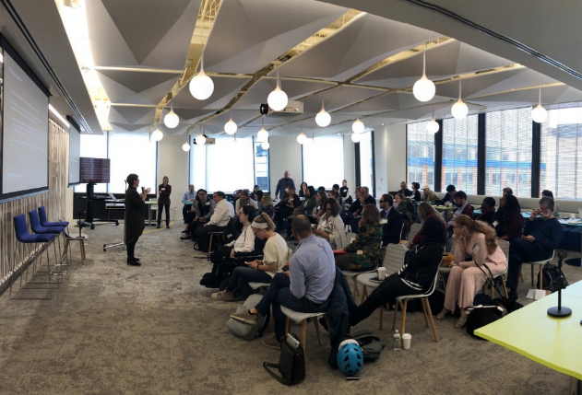
Academic Conferences
Learn
Develop new ideas
Demonstrate expertise
Increase visibility
Network
Find collaborators
Engage with eminent researchers

Slide 5
NEURIPS Survey 2018
12% of participants reported some difficulty seeing,
8% remembering/concentrating,
7% communicating,
4% hearing,
1.5% walking/climbing stairs
1.4% had accessibility-related difficulties at the conference.
  Poster sessions required a long period of standing and were noisy and crowded
  Talks assumed good color vision
  Finding safe food to eat was a challenge

Slide 6
Scary Stories
Attending conferences can be risky!
When her mobility scooter wouldn’t fit into the bathroom, an attendee struggled to walk the distance to the bathroom stalls and nearly fell
A power wheelchair user shaking with nerves was afraid they would accidentally drive their wheelchair off the edge of the stage
A blind speaker fell off a stage
An attendee couldn’t get into the shower in the conference hotel
An attendee ended up in hospital from poor air quality
Notes:
There is so much that conference organizers can do to enable people with disabilities to confidently attend, and get the most out of our conferences,
and to enable them to make informed decisions about whether it is safe to attend.

Slide 7
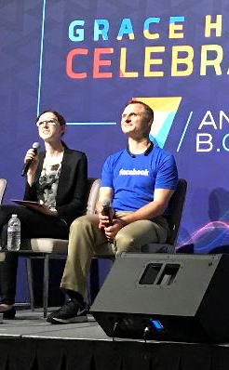
Visual Impairment
Accessible Website and proceedings
  Meet accessibility standards
  Work with access technologies
  Proceedings in advance
Orientation tour before the conference starts
Student volunteer available as a guide
Presenters describe visual materials
Shiri Azenkot (Cornell Tech)
Matt King (Facebook)

Slide 8
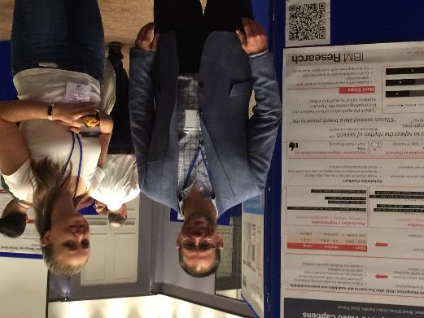
Deaf and Hard of Hearing
Budget for sign language interpretation or captioning
  for conference sessions, breaks and social events
Venue with an induction loop or assistive listening devices
Captions for all videos
Microphones for all presentations and questions
Quiet space where attendees can talk
Brent Shiver
(IBM Engineer)

Slide 9
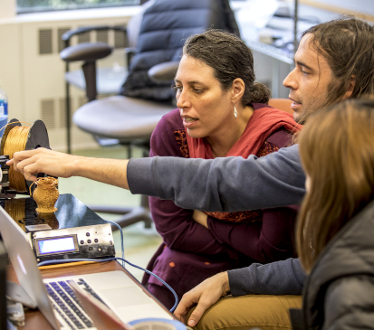
Mobility Impairments
Wheelchair accessible transport to the venue
Wheelchair accessible venue and social events
Accessible hotel rooms available for attendees
A ramp onto the stage, safety rails for speakers
Advance information about walking distances
Alternatives to stairs or long walks
Places to rest
Seating and low tables at social events
Student volunteers to assist
Jennifer Mankoff
(U Washington)

Slide 10
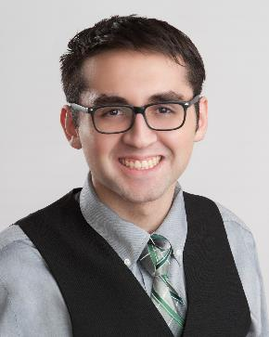
Neurodiversity
Advance description
  Will there be spotlights, strobes, loud music
  Where will audio speakers be located
Proceedings in advance
Meditation room or quiet space
Access to aisle seat
Inclusive attitude
  Use literal communication
  Allow time to process and respond
  Assume intelligence
Sebastien La Duca
(CMU)

Slide 11
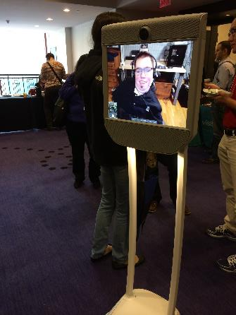

Special Diets
Food that is safe to eat
Labelled
Detailed ingredient lists
Prepared without cross-contamination

Slide 12
What does it take?
Appoint an Accessibility Chair (or two!)
Choose an accessible venue
Budget for accommodations
Provide an accessibility FAQ
Make the conference website accessible
Support authors in creating accessible papers and presentations
Gather requests at registration and follow up
Train SVs to assist
At the conference, set expectations and enforce them
Notes:
If this all sounds a bit overwhelming, don’t worry. There are lots of resources available.
A good place to start

Slide 13
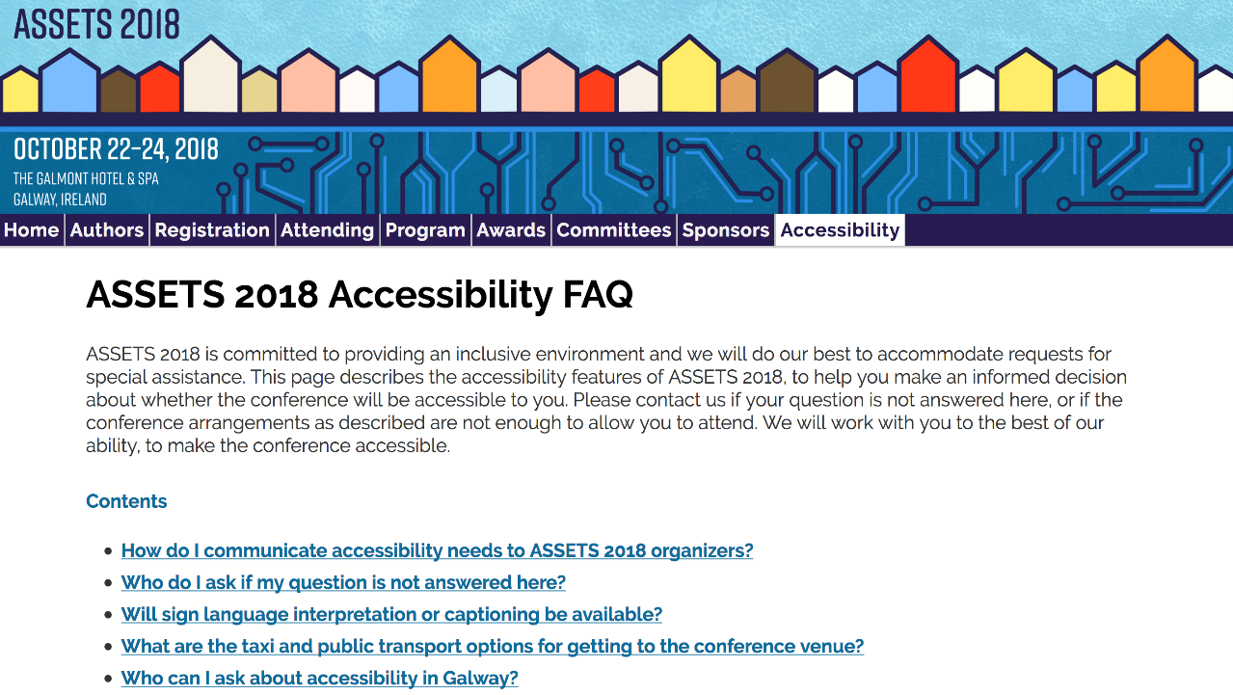
Frequently Asked Questions

Slide 14
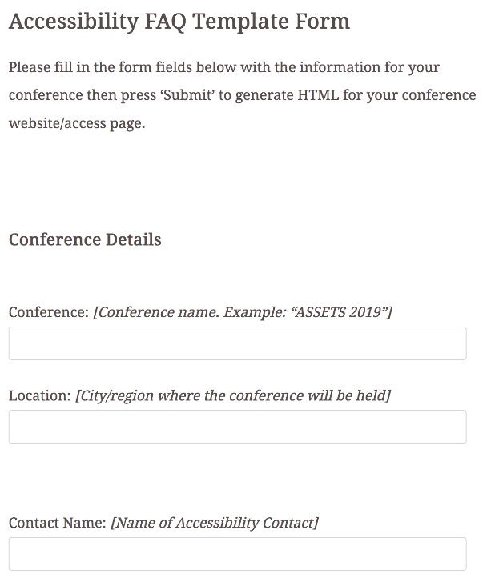
FAQ Generator
Prompts for
  conference details
  contact information
  important access information
Generates HTML for an FAQ page
Edit the page to add final touches
Serve at conference.org/access

Slide 15
SIGACCESS Resources
www.sigaccess.org/resources
Accessible Writing Guide
Accessible PDF Author Guide
Accessible Presentation Guide
Accessible Conference Guide (Endorsed by SIGACCESS, SIGCHI)
Accessibility FAQ Page Generator

Slide 16
See also
SIGCSE 2019 Guide for session chairs (Stacy Branham)
SIGCSE 2019 Guide for presenters (Stacy Branham)
CHI 2019 Guide for student volunteers (Anne Ross)
CHI 2020 Venue accessibility walkthrough (Kyle Rector and Shari Trewin)
Accessibility timeline (Shari Trewin and Jen Mankoff)
SIGACCESS will post general versions of these in future

Slide 17
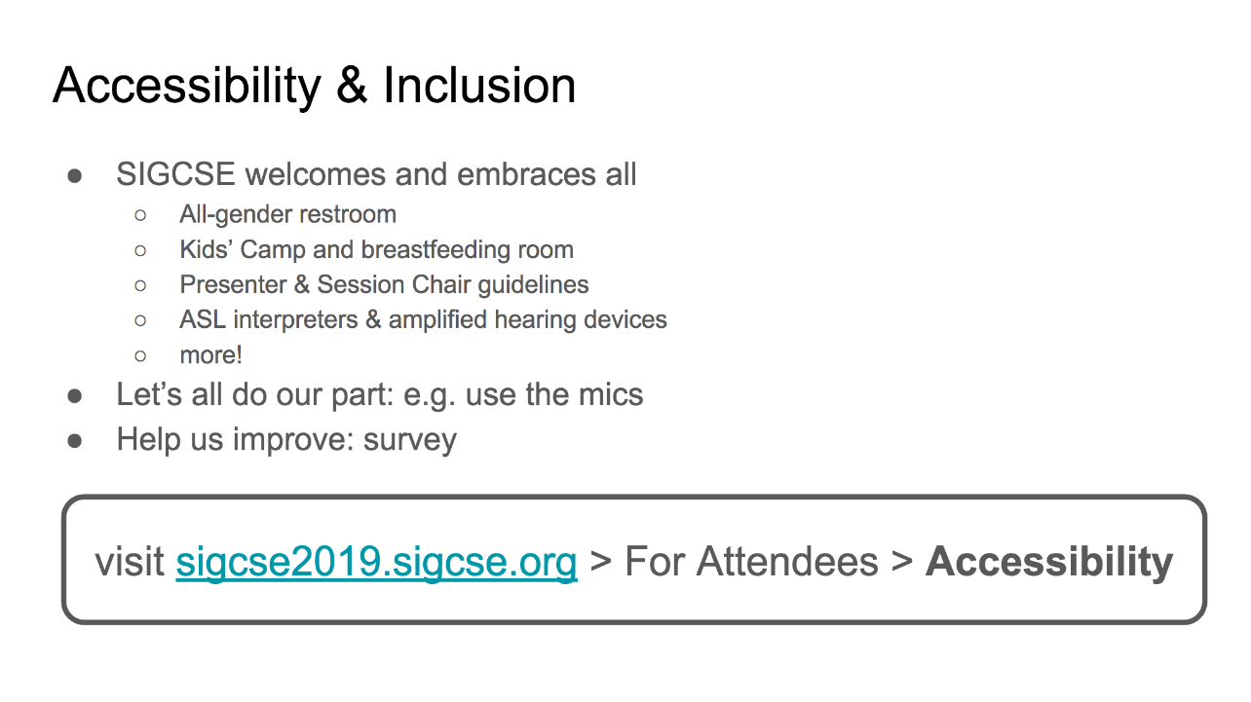
Notes:
This is Stacy Branham’s slide, presented at SIGCSE 2019 opening plenary.
Here’s what she said:
Manuel and Beth and the entire program committee have been extremely supportive in trying to convey through their actions that SIGCSE is a community that welcomes and embraces all.
We have an all gender restroom
Resources for parents with children
Guidelines for running accessible sessions and presentations
Service for people who are d/Deaf and hard of hearing
And more!
I would like to take a moment to share with you something I learned after becoming an I accessibility researcher in 2014. By this time, I had attended many conferences, but I’d never realized that accessibility is not just up to the conference organizers. There are little steps that all of us can take to provide a more inclusive space.
Here’s one small example:
When you’re in a talk and the speaker insists that...
:: I walked away from mic and said “they can project” then walked back to the mic ::
...don’t listen to them, because other people in the room can’t hear them.
They have good intentions. So, kindly raise your hand and ask the speaker to use the microphone.
If you’re interested to learn about other ways you can promote accessible and inclusive practices at the conference, take a look at our accessibility webpage. Go to sigcse2019.sigcse.org, click For Attendees, click Accessibility.
Finally, I encourage you to find the link to the survey on the webpage, and give us feedback about how to improve next year.
Now, I’d like to invite you to join me in giving yourselves a preemptive round of applause to thank you for doing your part to make SIGCSE 2019 great!

Slide 18
Questions?
Your one-stop shop:
www.sigaccess.org/resources

