Slide 1
ACM History Committee
SIG Heritage Workshop
12 October 2018
contact: Tao Xie (SGB Liaison), taoxie@illinois.edu
Kim Tracy, tracy@rose-hulman.edu
http://history.acm.org/

Slide 2
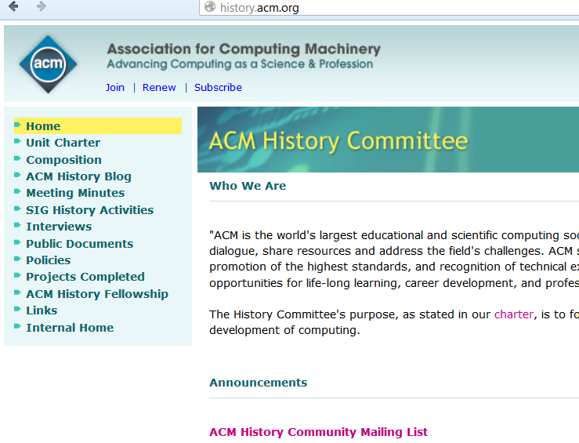
History Comm. Mission
Created in July 2004
The History Committee fosters collection, preservation, and interpretation of the history of the ACM and its role in the development of computing.
To this end, the committee provides guidance within the Association and carries out activities independently and in collaboration with other groups.
  Publications Board Liaison
  SGB Liaison

Slide 3
ACM History Comm. Members
Barbara Boucher Owens
  Chair, Southwestern University, (Chair July 2018 - )
Chuck House
  Past Chair, Innovascapes, (Chair July 2016-June 2018)
Tao Xie
  SGB Liason, Univ. of Illinois at Urbana-Champaign
Vicki L. Almstrum, Texas State University
Carol Hutchins, Courant Institute Library
Roy Levin, retired
Bernadette Longo, New Jersey Institute of Technology
Sachin Maheshwari, Emeritus faculty CSE, IIT Delhi, India
Ursula Martin, University of Oxford
Erik Rau, Hagley Library
Len Shustek, Computer History Museum
Kim Tracy, Rose-Hulman Institute of Technology
Mary Whitton, University of North Carolina at Chapel Hill
Jeffrey Yost, Charles Babbage Institute

Slide 4
2019 SIG Heritage Workshop
One and ½ day workshop at U. Minnesota/Charles Babbage Inst. to share examples, support, and practices to preserve ACM SIG history for ACM membership.
May 20-21, 2019
Travel support!
J. Sammet collection at CBI.
Sutherland, ”Sword of Damocles,” 1968.
FJCC Petition origin for SIGCSE, 1968.
Computing History collection at CBI (Atlas 1)
http://history.acm.org/public/public_documents/ACM-SIG-Heritage-workshop_2019-05.pdf

Slide 5
ACM SIGs and ACM History
Unique resources for chronicling development of all aspects of computing through membership activities, conferences etc.
Well-positioned to preserve and protect past documentation that can help tell full story of ACM’s leadership and contributions
Many SIGs are having important anniversaries
Natural source for oral histories; publishing history of the area and SIG

Slide 6
Workshop Goals
Share formal archival agreements & procedures
  Charles Babbage Institute (paper & digital artifacts)
  Computer History Museum (for physical artifacts)
Share process to encourage and guide each SIG in archiving materials they collect
Train and support SIG Heritage historians in systematic process of collecting materials, interviews
Support SIG historians in writing articles about SIG’s history from SIG concept through present day

Slide 7
Summary
SIG Heritage Workshop
  Designed to help SIGs preserve history of
    SIG
    ACM
    Computing as a whole
  Details:
    May 21st to May 22nd, 2019 (1 ½ days)
    At Charles Babbage Institute
    ACM HC funding travel (see CFP)
http://history.acm.org/
http://history.acm.org/content.php?do=blog

